Slide 1
RELIABLE Task Scheduling in heterogeneous distributed systems
Presented by,
M. Bhirundha
P. RajaPriya
S. Sri Sruthi
Mepco Schlenk Engineering College, Sivakasi.(Autonomous)

Slide 2
Aim:
To increase the performance and reliability by scheduling the tasks considering fault recovery

Slide 3
Objective:
To reduce the expected execution time by replicating the tasks.
To implement two phase algorithm
First Phase - Find favorable number of replication of tasks
Second phase - Scheduling algorithm
Consists of two Strategies
First strategy - No replication of tasks can be stopped
Second strategy - Once the replication of a task is completed the other replicas are stopped

Slide 4
Notations:
Topology of Distributed System: Undirected Graph : GT = ( P , L )
P – Set of m processors (p₁ , p₂ ,… p_{m} ) .
L – Set of Links.
l_{i,j} - Bidirectional Communication link between p_{i} , p_{j}
w (p_{i}) – weight of p_{i} (Computation Capacity).
w(l_{i,j}) - weight of edge l_{i,j.} (Communication Capacity).

Slide 5
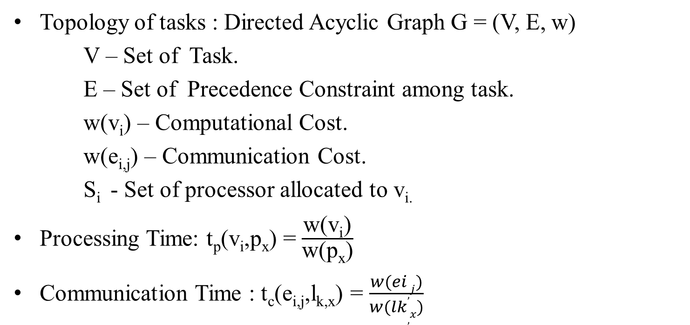
Notations (contd..):
Topology of tasks : Directed Acyclic Graph G = (V, E, w)
V – Set of Task.
E – Set of Precedence Constraint among task.
w(v_{i}) – Computational Cost.
w(e_{i,j}) – Communication Cost.
S_{i} - Set of processor allocated to v_{i.}
Processing Time: t_{p}(v_{i},p_{x}) = $\frac{\text{w}\text{(}\text{vi}\text{)}}{\text{w}\text{(}\text{p}\text{x}\text{)}}$
Communication Time : t_{c}(e_{i,j},l_{k,x}) = $\frac{w(ei,j)}{w(lk,x)}$

Slide 6




Flow Diagram
Start
Generate task graph
Compute RRank
Read inputs from files
Sort Task according to the RRank in descending order
Normalize the parameters
Schedule the task
Calculate allotment lower bound for each task
Scheduled task with processors
Compute allotment parameter
Stop
A

Slide 7
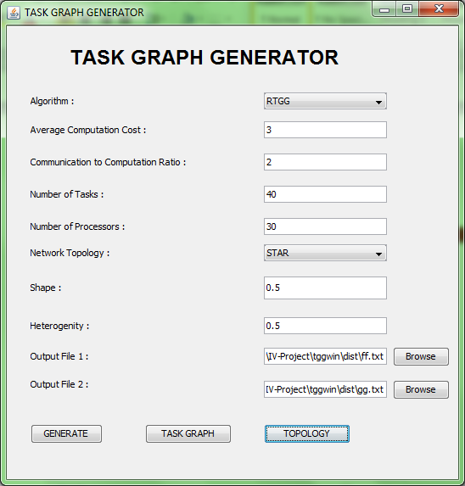
SCREENSHOT:

Slide 8

Allotment Problem: Methodologies: Allotment Lower Bound
In the Strategy I
AL(i) = 1 for all 1 <= i<= n
In the Strategy II
for i<- 1 to n do
if $\frac{tp(vi)}{θp}$>= f₁(v_{i} ,1) then
AL(i) = 1
else if $\frac{tp(vi)}{θp}$< f₁(v_{i} ,m - 1) then
AL(i) = m
else
Find a number j ϵ [1, m – 2] such that
f₁(v_{i} , j + 1) <= $\frac{tp(vi)}{θp}$< f₁(v_{i} , j)
AL(i) = j + 1

Slide 9
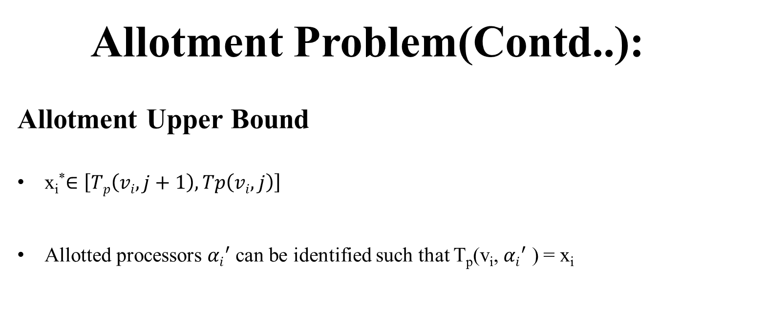
Allotment Problem(Contd..):
Allotment Upper Bound
x_{i}*$∈\left[Tp\left(vi,j+1\right),Tp\left(vi,j\right)\right]$
Allotted processors ${αi}^{′}$ can be identified such that T_{p}(v_{i}, ${αi}^{′}$ ) = x_{i}

Slide 10
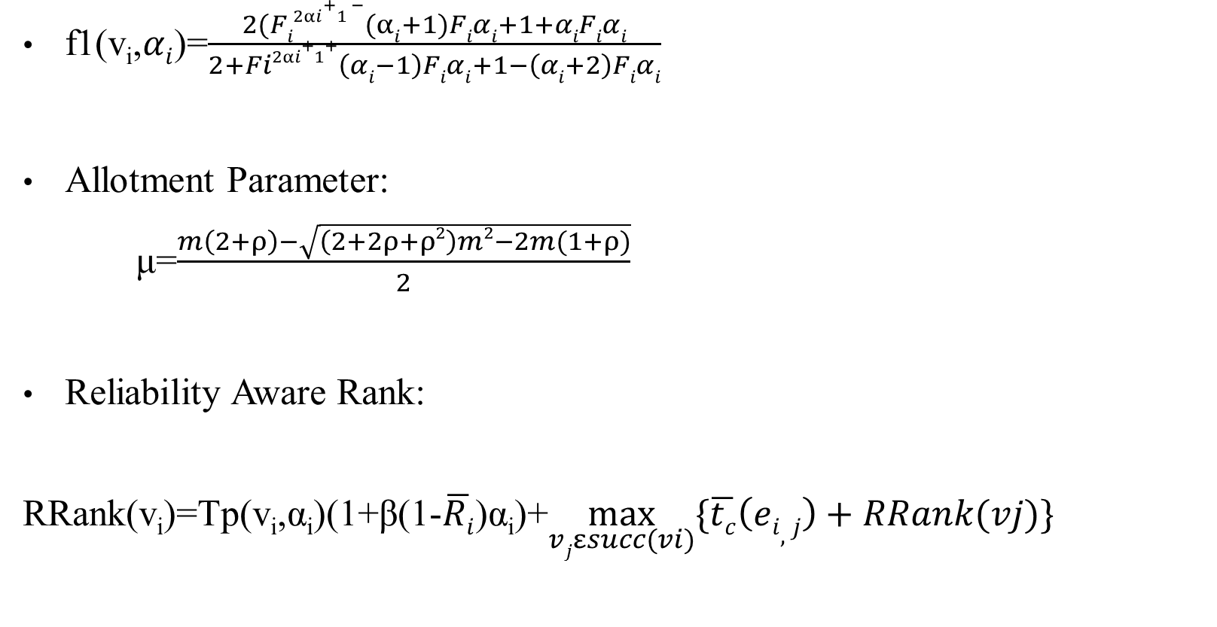
Allotment Problem(Contd..):
f1(v_{i},$αi$)=$\frac{2(Fi2αi+1 −(αi+1)Fiαi+1+αiFiαi}{2+Fi2αi+1+\left(αi−1\right)Fiαi+1−\left(αi+2\right)Fiαi}$
Allotment Parameter:
μ=$\frac{m\left(2+ρ\right)−\sqrt{\left(2+2ρ+ρ2\right)m2−2m(1+ρ)}}{2}$
Reliability Aware Rank:
RRank(v_{i})=Tp(v_{i},α_{i})(1+β(1-$\overline{Ri}$)α_{i})+$\max_{vjεsucc(vi)}{\{\overline{tc}\left(ei,j\right)+RRank(vj)\}}$

Slide 11
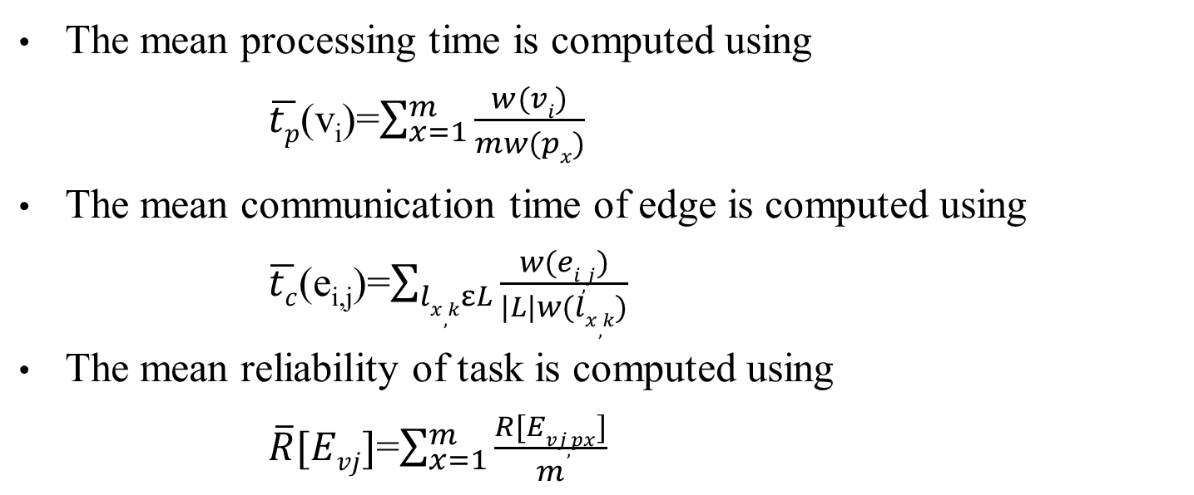
Normalization Step:
The mean processing time is computed using
$\overline{tp}$(v_{i})=$\sum_{x=1}^{m}{\frac{w(vi)}{mw(px)}}$
The mean communication time of edge is computed using
$\overline{tc}$(e_{i,j})=$\sum_{lx,kεL}{\frac{w(ei,j)}{|L|w(lx,k)}}$
The mean reliability of task is computed using
$\overline{R}[Evj]$=$\sum_{x=1}^{m}{\frac{R[Evj,px]}{m}}$

Slide 12
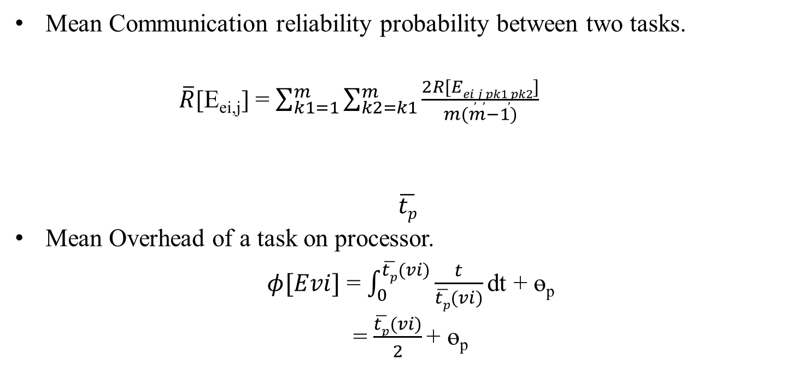
Normalization Step(Contd..):
Mean Communication reliability probability between two tasks.
$\overline{R}$[E_{ei,j}] = $\sum_{k1=1}^{m}{\sum_{k2=k1}^{m}{\frac{2R[Eei,j,pk1,pk2]}{m(m−1)}}}$
$$\overline{tp}$$
Mean Overhead of a task on processor.
$φ[Evi]$ = $\int_{0}^{\overline{tp}(vi)}{\frac{t}{\overline{tp}(vi)}\text{dt}\text{ + }\text{ө}\text{p}}$
= $\frac{\overline{tp}(vi)}{2}$ $\text{+ }\text{ө}\text{p}$

Slide 13

Makespan Problem :
Earliest Computation Finish Time
EFT(v_{i},p_{k},S_{i})=EST(v_{i},p_{k})+tp(v_{i,k})+$\frac{F}{1−F}(\frac{tp\left(vi,k\right)}{2}+θpk)$
Earliest Communication Finish Time
EFT(e_{i,j},S_{i},p_{x})=$\frac{1}{|Si|}\sum_{k∈Si}{(EFT\left(vi,p_{k},Si\right)+tc(ei,j,lk,x))}$

Slide 14
Proposed Algorithm :
The Allotment aware scheduling :
Normalize the heterogeneous system into a homogeneous system.
Compute allotment parameter α’ by the linear program and the rounding procedure.
Compute α_{i} = max {min {α’_{i} , µ}, AL (i)} for v_{i} ϵ V.
Compute RRank for all tasks by traversing graph from the exit task.
Sort the tasks in a scheduling list by non – increasing order of RRank

Slide 15
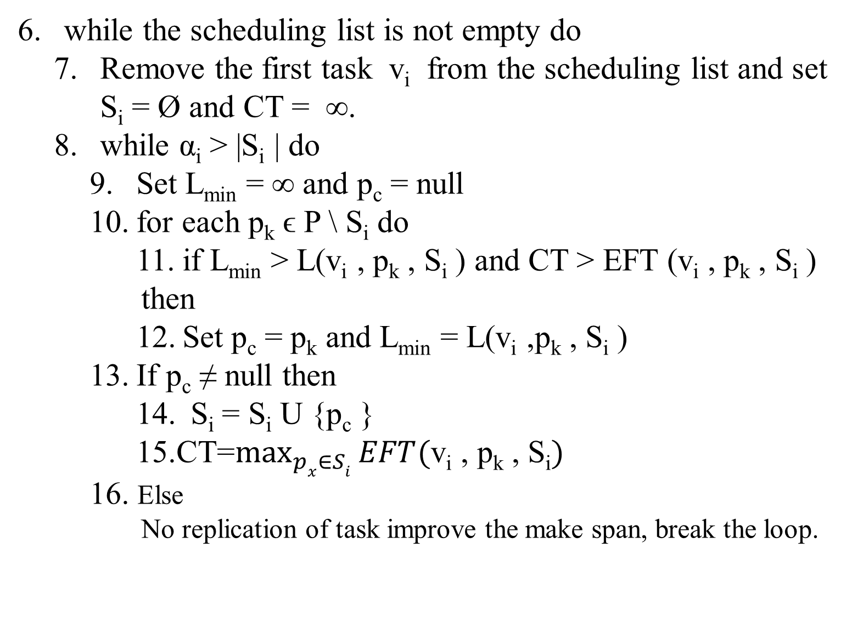
Proposed Algorithm (Contd..):
while the scheduling list is not empty do
Remove the first task v_{i} from the scheduling list and set S_{i} = Ø and CT = ∞.
while α_{i} > |S_{i} | do
Set L_{min} = ∞ and p_{c} = null
for each p_{k} ϵ P \ S_{i} do
11. if L_{min} > L(v_{i} , p_{k} , S_{i} ) and CT > EFT (v_{i} , p_{k} , S_{i} )
then
12. Set p_{c} = p_{k} and L_{min} = L(v_{i} ,p_{k} , S_{i} )
If p_{c} ≠ null then
14. S_{i} = S_{i} U {p_{c} }
15.CT=$\max_{px∈Si}{EFT(\text{v}\text{i}\text{ , }\text{pk}\text{ , }\text{Si})}$
16. Else
No replication of task improve the make span, break the loop.

Slide 16
Expected Time Procedure :
Compute the reliability probability R = e^{-λtp(v,p)} for the task v on the processor p and set t = t_{p}(v,p).
Get a number n ε [0,1] uniformly at random.
While n > R do
Get a number p ε [0,1] uniformly at random
t = t+p * t_{p}(v,p) + 𝞱
Get a number n ε [0,1] uniformly at random.

Slide 18

$SLR= \frac{makespan}{\sum_{v_{i}∈CP_{min}}{\min_{p_{j}∈P}t_{c}(v_{i},p_{j})}}$

Slide 19
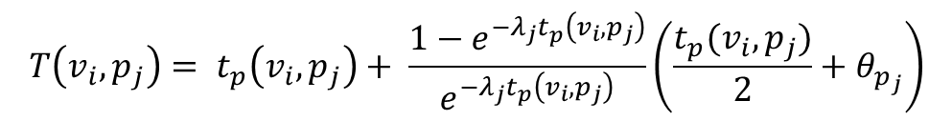
$$T\left(v_{i},p_{j}\right)= t_{p}\left(v_{i},p_{j}\right)+ \frac{1−e^{−λ_{j}t_{p}^{}\left(v_{i},p_{j}\right)}}{e^{−λ_{j}t_{p}\left(v_{i},p_{j}\right)}}\left(\frac{t_{p}(v_{i},p_{j})}{2}+θ_{p_{j}}\right)$$

Slide 20
THANK YOU

